Slide 1


Causes of Conflict

Slide 2
Learning Objectives
01
To enable students to understand the reasons of conflicts
02
3
Causes of Conflict

Slide 3

Why does conflict arise?

Slide 4


Slide 5

No two people are alike

Slide 6
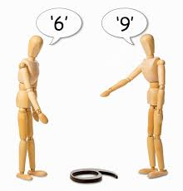
See things differently

Slide 7

Different ideologies

Slide 8

Different approaches to problem-solving

Slide 9

Poor communication channels

Slide 10
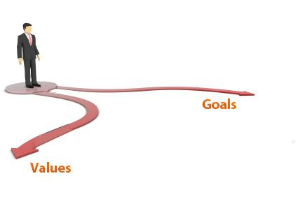
Differences in goals and values

Slide 11
Thank you

